Slide 1

SKYDROP
Auto drone delivery system
By Karunya ,Ismail and Rao

Slide 2
Current delivery challenges
High Operational Costs: Significant expenses in fuel, vehicle maintenance, and human labor.
Traffic Congestion & Delays: Urban traffic causes unpredictable delivery times and inefficiency.
Environmental Impact: Traditional vehicles contribute to carbon emissions and noise pollution.
Limited Accessibility: Reaching remote or hazardous areas is often difficult and costly.
Slow Delivery Times: Consumers demand instant gratification, which current methods struggle to meet.

Slide 3
Reliability
Category | Consideration | Details
Reliability | Operation Area | Should function in both urban and suburban locations.
 | GPS Dependency | GPS signals are strong in urban areas but may be weak or inconsistent in suburban or remote regions.
 | Weather Simulation | Must be tested and reliable in all weather conditions (rain, wind, fog, etc.).
 | Signal Interference | Ensure communication is stable despite interference from buildings or devices.
 | Maintenance & Health Check | Regular system diagnostics and preventive maintenance schedules.
 | Redundancy Systems | Backup systems for navigation and communication to avoid mission failure.

Slide 4
Safety
Category | Consideration | Details
Safety | Collision Avoidance | Implement sensors (e.g., LiDAR, ultrasonic) for avoiding birds, drones, buildings.
 | Package Security | Mechanisms to ensure package is locked until delivery is complete. Facial recognition of customers for valuable products .
 | Emergency Landing | Protocols for safe emergency landing in case of failure. Smart airbag to protect the product and drone .
 | Battery Management | Intelligent battery checks and alerts based on delivery distance and weather. Using thin film solar cells . Battery charging hub . Wireless charging ports with minimal space occupancy
 | No-Fly Zone Compliance | System should respect restricted areas (airports, military zones).
 | Fail-Safe Mechanisms | Auto-return or hover features in case of signal or power loss.

Slide 5
Trustworthiness
Category | Consideration | Details
Trustworthiness | Public Awareness | Campaigns to educate and inform the public on how drone delivery works. Simple trial to regular customers and feedback recording
 | Transparency | Provide real-time tracking and delivery updates to customers.
 | Delivery Consistency | Delivery timing and quality should remain consistent.
 | Data Privacy | Secure handling of user data, location, and delivery information. Hiding people faces unless its customer receiving package . Using infrared imaging in general while navigating through cities
 | Regulatory Compliance | Adherence to local aviation and drone operation laws.
 | Feedback Loop | Enable customers to report issues or rate delivery for continuous improvement.

Slide 6

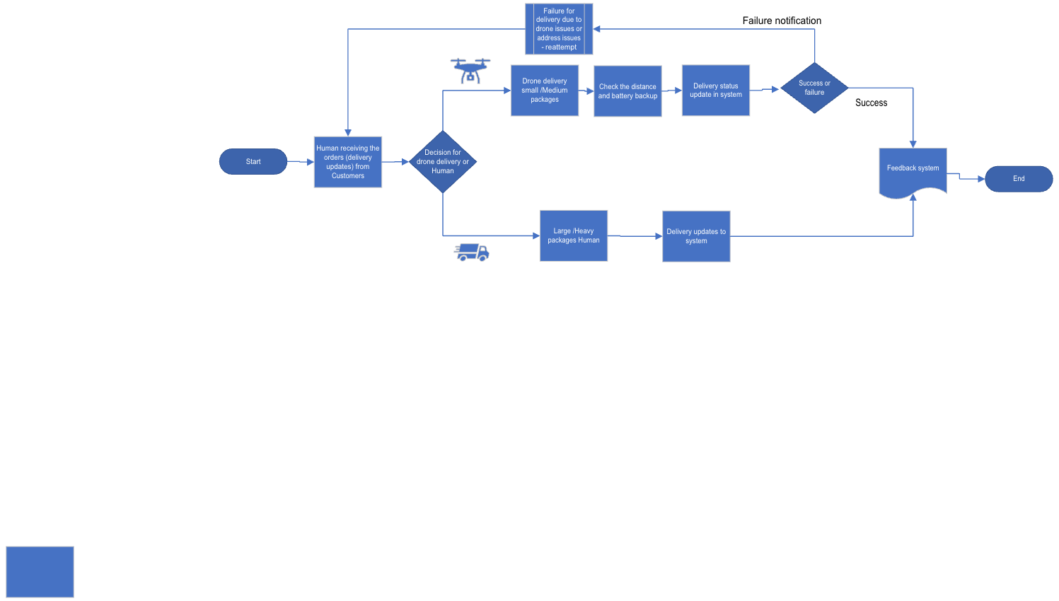
HUMAN ASSISTED DESIGN

Slide 7
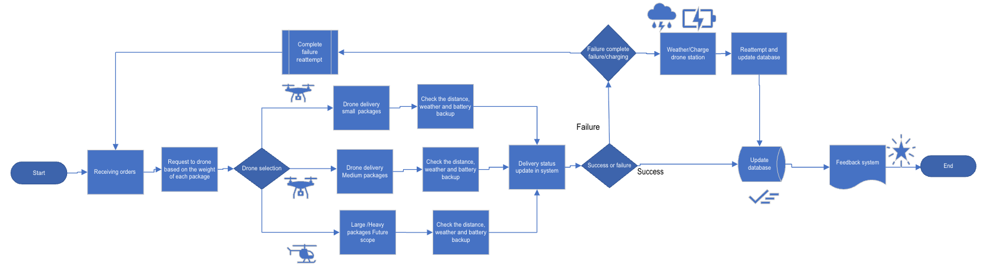
AUTO DESIGN

Slide 8





IMPLEMENTATION ROADMAP
Phase 1: Market Entry
Phase 2: Implement for small scale
Phase 3: Launch & Expansion
Phase 4: Ongoing Operations & Growth
Market entry with Human assisted drone system
Implement complete automated drone system for Medicine delivery and other small scale food delivery
Expand fully automatic for other deliveries . Target Sub-urban and rural
Record feedback and success stories . Other operation to Large scale .

Slide 9
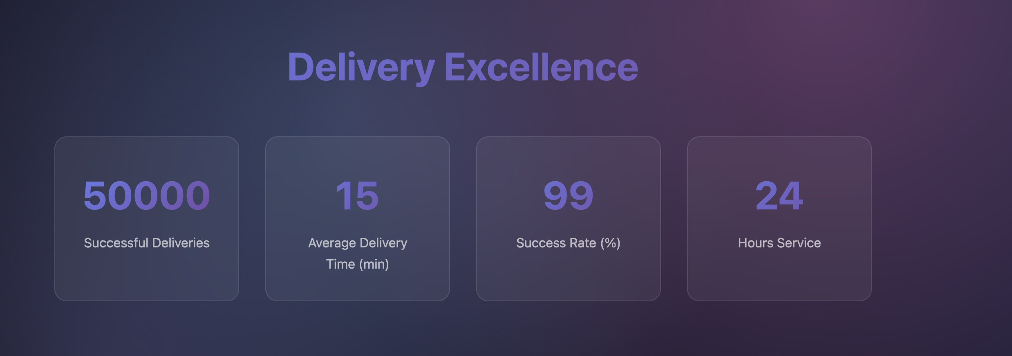
Delivery Excellence

Slide 10
Thank you
Website link : https://karunyadhana6.github.io/Taskmanager1/drone_delivery.html

